Slide 1
GHRM
Orientation
國立中山大學人力資源管理全英語碩士學位學程
行政人員 林欣郁 Cindy Lin

Slide 2
GHRM 103 Orientation
Date, 2014/9/13 (六) | Activity | Place
10:00am~ 10:15am | Registration (Cindy) | R1036
10:20am~ 10:50am | GHRM Overview (Cindy) | R1036
11:00am~ 11:30am | GHRM 103 Students’ Self Introduction | R1036
11:50am~14:00pm | Lunch | Sizihwan Sunset Beach Resort
14:00pm~14:30pm | Campus Tour | NSYSU Campus
14:30pm~15:30pm (Optional) | Beach Volleyball | Sizihwan Sunset Beach

Slide 3

Location & Program team
  The GHRM office is located in room 3046 on the 3 floor in the College of Management.
  Program director is professor Jin Feng Uen (room 3014-1,TEL: 07-5252000 ext.4935, Email: uen@cm.nsysu.edu.tw).
  Program coordinator Janet Chen and Cindy Lin.
  Contact: cindy@staff.nsysu.edu.tw TEL: 07-5252000 ext.4941

Slide 4

Agenda
Program Features
Learning Goal
Program Design
About Kaohsiung
Tips

Slide 5
Program Features
Cross-cultural
Globalization and internationalization
    Foreign exchange
    Ongoing Double degree Cooperation
Combined with the enterprise
    Business visit
    Internship project
    Industrial Independent Study

Slide 6
Learning Goal
Multinational culture understandings
Transnational HRM talents
Unite global HRM specialists and experts
Multi-language skills

Slide 7
Program Design
Degree Requirements ：
Graduation credits 39 credits
For local students, minimum required at least should take no less than two courses related to management from overseas exchange within 1 semester
International students should reach Chinese proficiency, TOCFL score level 2 (A2) or New HSK score level 2
TOEFL score IBT79-80(IELTS6)
English Thesis

Slide 8
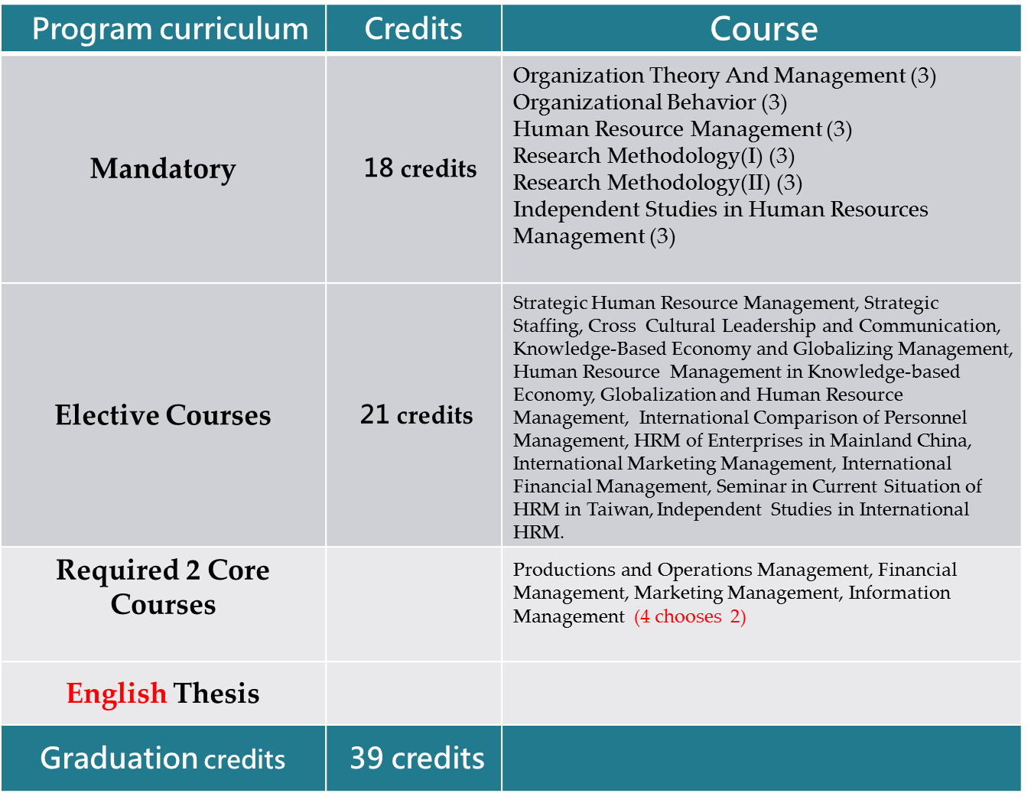
Program Structure

Slide 9
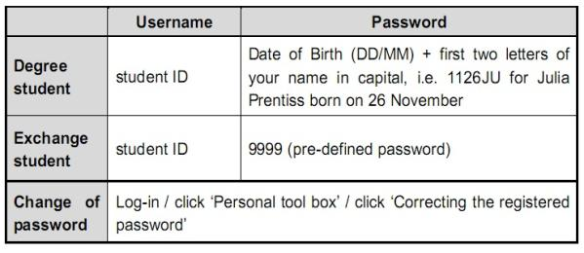

Course Selection
Course Selection Websites
http://selcrs.nsysu.edu.tw/smain.asp?eng=1
Enter your account number and password. Next add/drop period is from September 22nd to the 24th.
http://selcrs.nsysu.edu.tw/menu1/qrycrsfrm.asp?HIS=1&eng=1
  Use this to see which courses are available. Set the Dept./Faculty to M461, then search. If you want to see what classes are taught in English check it, and you can look at other departments besides IBMBA.
Password Information

Slide 10
Important!
Courses you add are not guaranteed to be included in the official record. You must log in to your account to confirm your selection record at the time of Result Announcement.
October 2nd-15th

Slide 11
ADD & DROP
There have two phases for you to add & drop if you still not yet select the courses or you select a wrong course which you want to drop.
Phase 1 –Sep 22nd to 24th, Result Sep 25th.
Phase 2- Sep 26th to 30th, Result OCT 1st.

Slide 12
Cyber University
http://cu.nsysu.edu.tw/index.php?en
Most course instructors use cyber university as a teaching platform. Course related materials, announcements and pertinent information will be posted on the board by the course instructor or the teaching assistant. It is important you visit CU on a regular basis.
The pre-defined log-in account and password are the same as course selection.

Slide 13
Scholarships/Part time jobs
Teaching Assistant
Research Assistant
Part time job offers
(NSYSU homepage→(draw down)→更多訊息→校園徵才)
GHRM office (website and Facebook maintenance)
School Scholarships
Office of International Affairs
http://oia.nsysu.edu.tw/files/11-1013-9029.php
GHRM website, http://ghrm.nsysu.edu.tw/
Facebook, https://www.facebook.com/nsysughrm

Slide 14
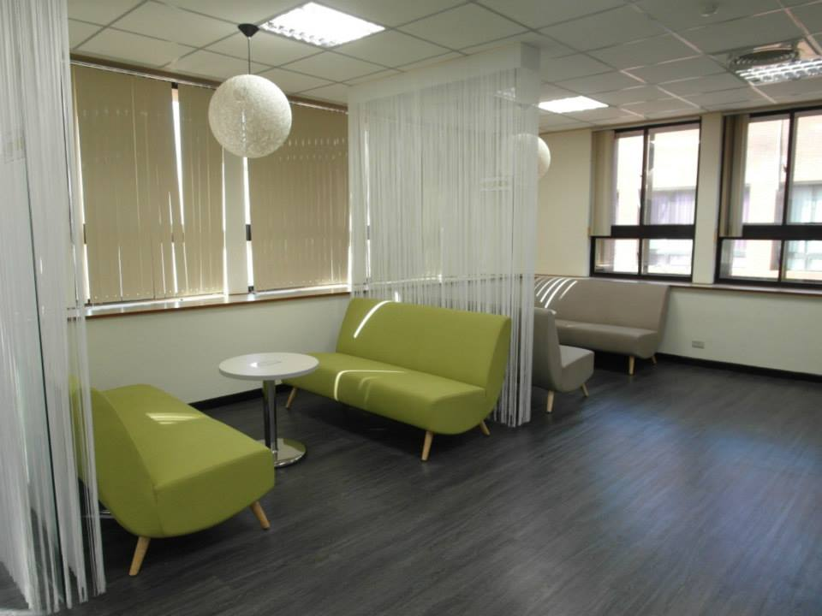

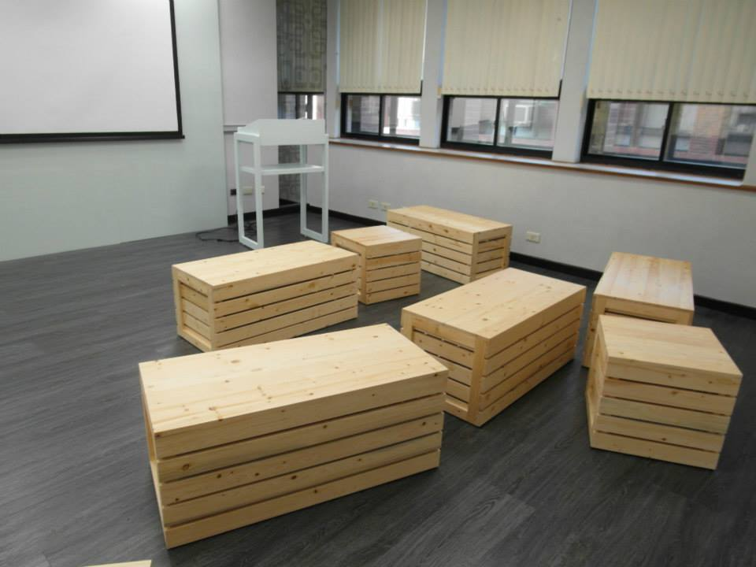
Study/Discussion Space
Student lab 0047 (deposit ntd100)
Library (Personal/Group Space)
台成清交及其他院校華語文中心及國際

Slide 15
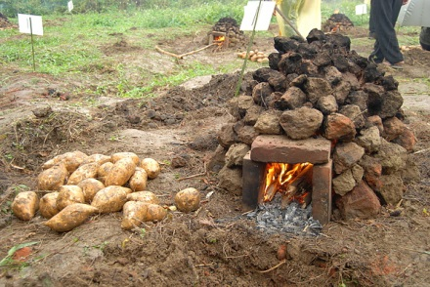
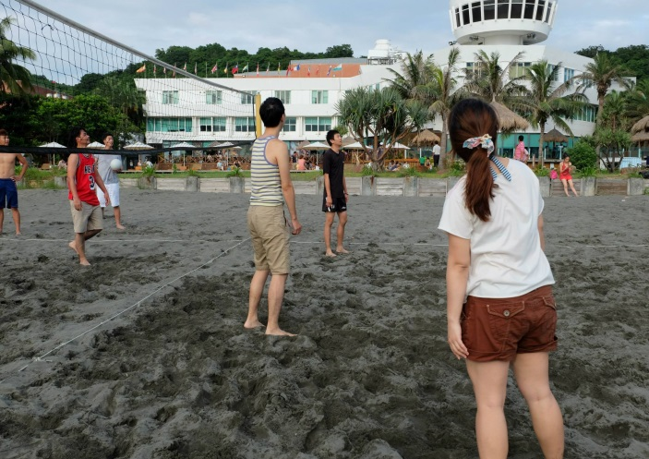
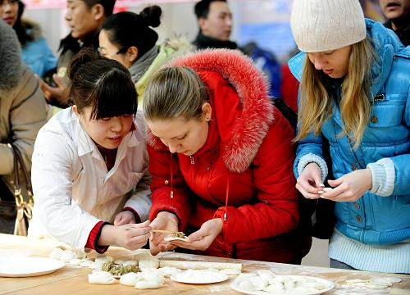
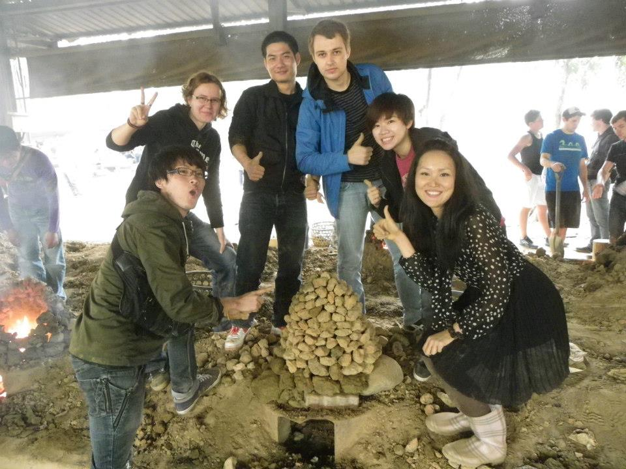

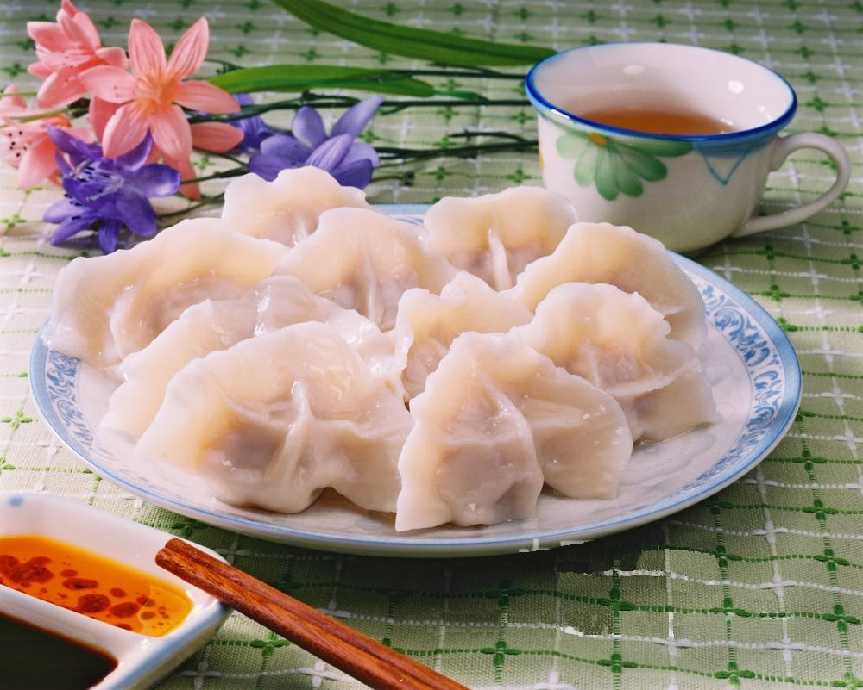
Extra curriculum activities

Slide 16
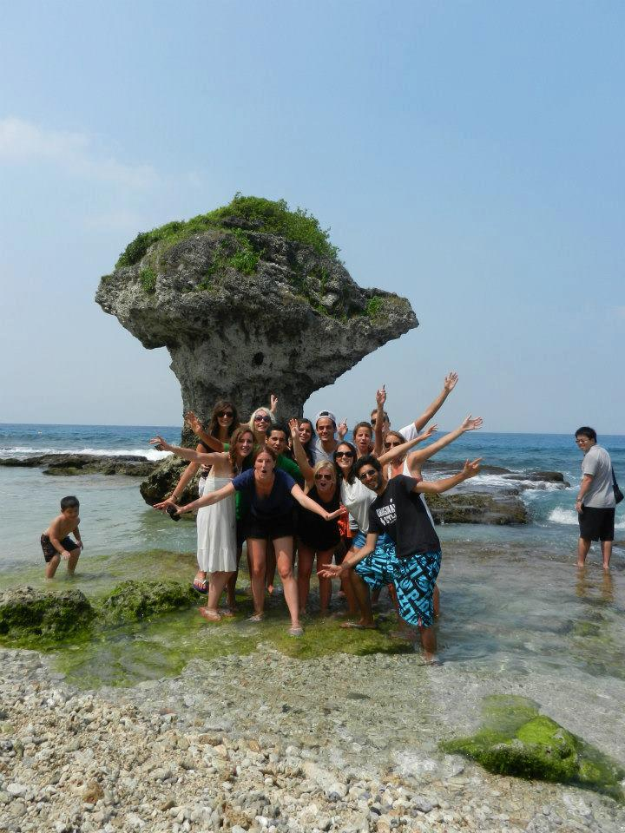


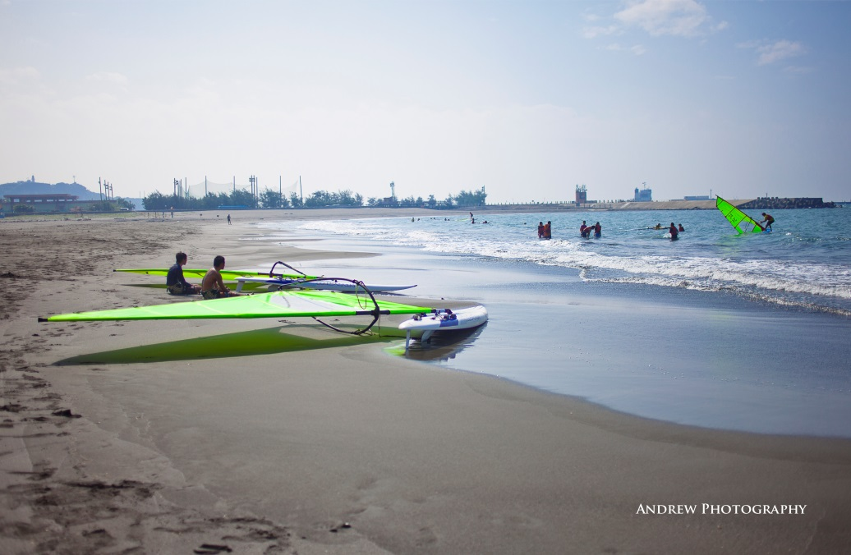

Enjoy Beauty of NSYSU
Beauty of NSYSU

Slide 17
WELCOME TO KAOHSIUNG

Slide 18
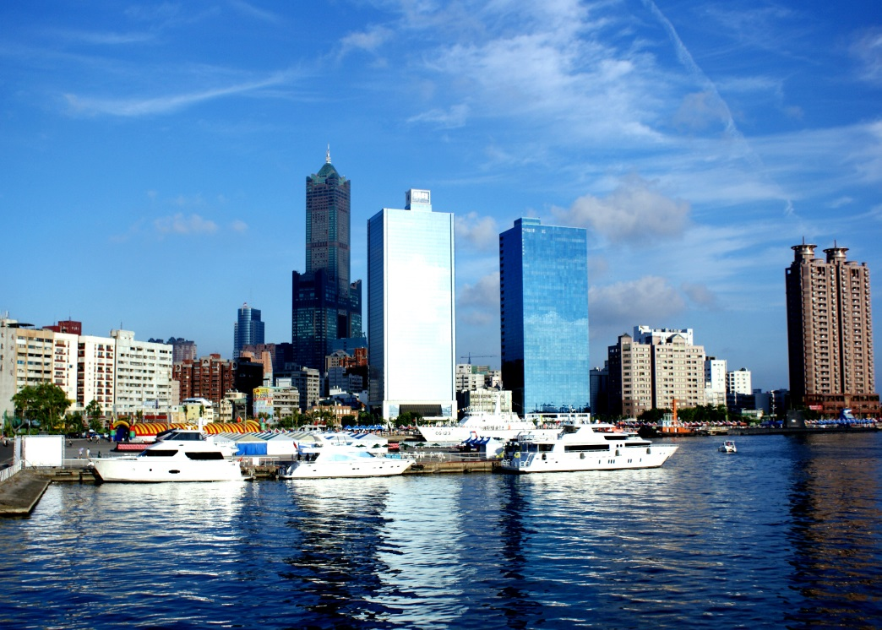
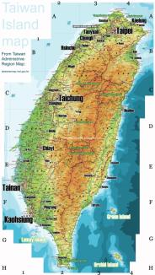
Kaohsiung, Taiwan
Port city
Southwest Taiwan

Slide 19
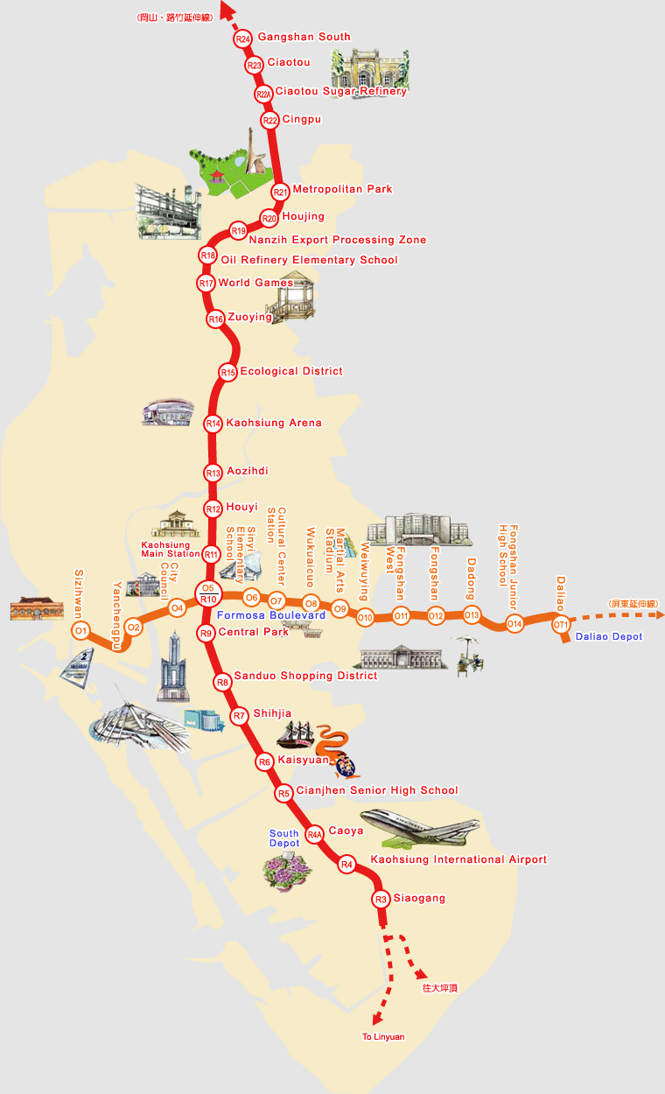
Kaohsiung Metro Lines
http://www.krtco.com.tw/en/index.aspx

Slide 20

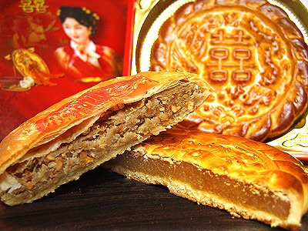

Places to go:
Agglomeration economic
Bridal street (中山一路)
Wedding cakes (中正四路)

Slide 21
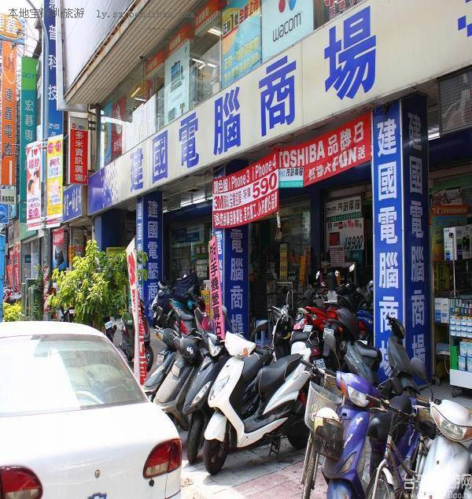
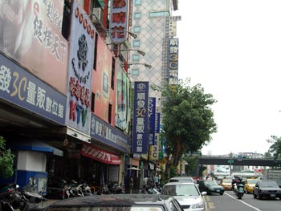
Places to go:
Agglomeration economic
Computer street
(建國路)

Slide 22
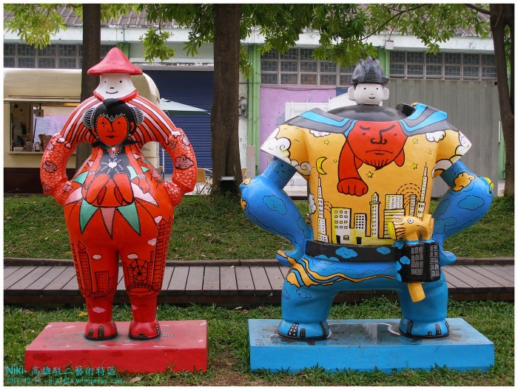
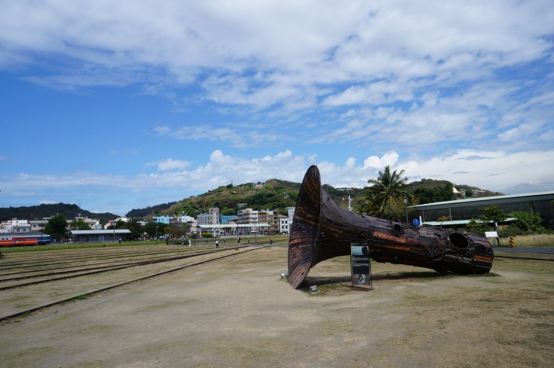
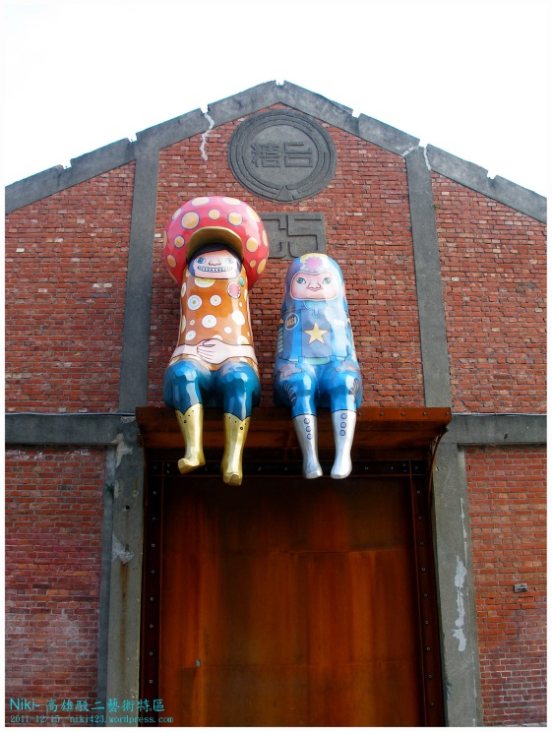
Places to go: Art & culture
The Pier-2 Art Center
Transformed from an old warehouse of Kaohsiung harbor
Loads of popular & fun exhibitions all year round!!

Slide 23
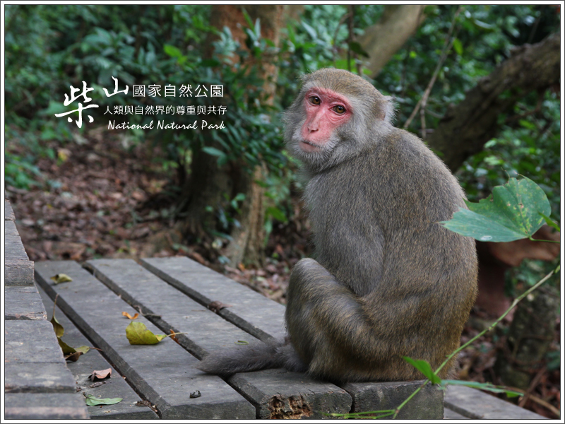
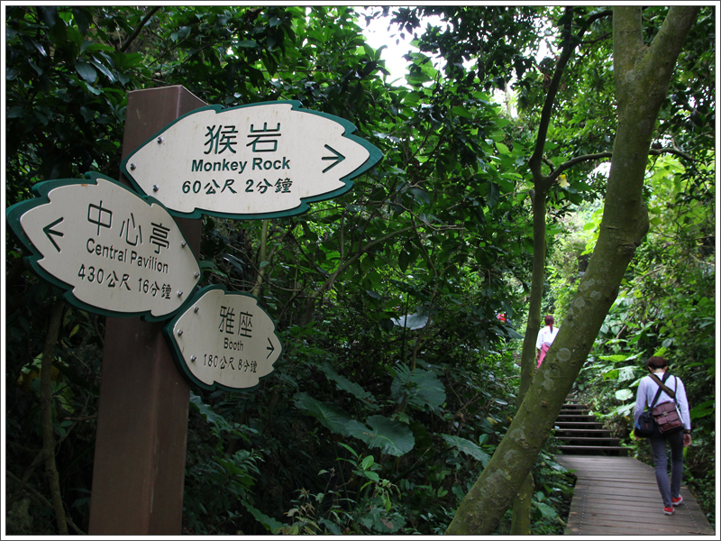
Places to go: Get in touch with the wild side
Shoushan hiking
- closest destination for light climbing exercise
- opportunity to see lots of wild monkeys!

Slide 24
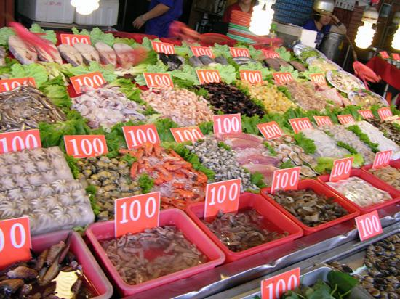
Places to go: things near NSYSU
NSYSU Art Center
- Art Performances easy to reach in low or no charges
Cijin
- One cheap ferry ride away (NT.15 per person)
- Fresh seafood
- and more…

Slide 25
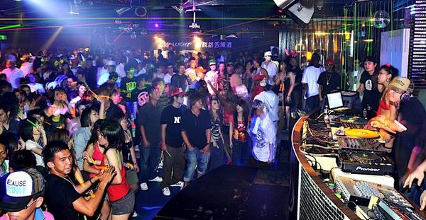
Clubbing in Kaohsiung
Brickyard
- Central park MRT station
Dreams
- Behind SOGO Department store (Sanduo Shopping
District Station)
Lamp
- Close to 85 Building

Slide 26
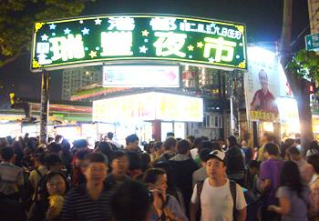
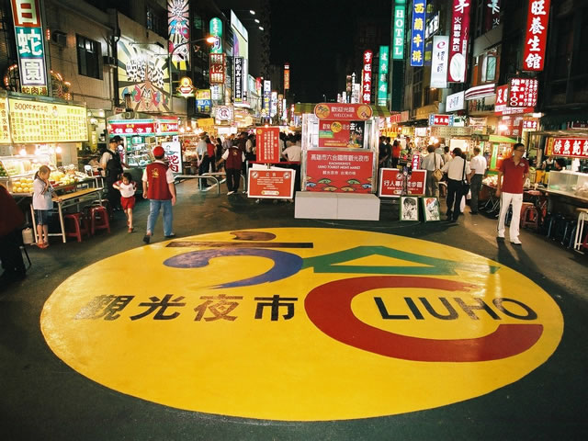
Night Markets
Rui-Feng
Liu-Ho

Slide 27
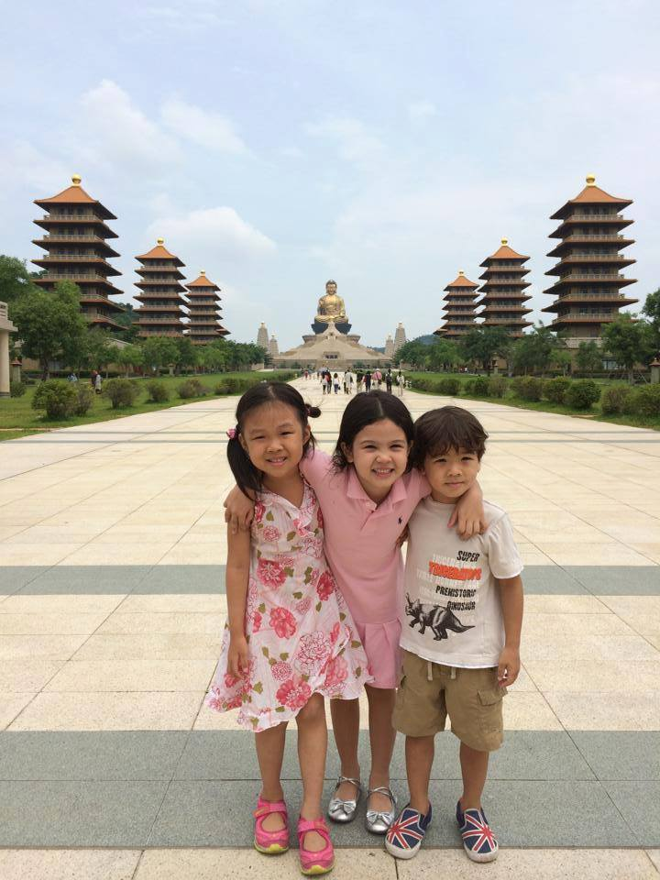

Cultural Spots
Lotus Lake
Fo-Guang Shan

Slide 28

Thank you and enjoy Kaohsiung

Slide 29

Thanks for your attention !
Any questions

